Slide 1
High availability and scalability on GNU/Linux clusters
Pieter Libin

Slide 2
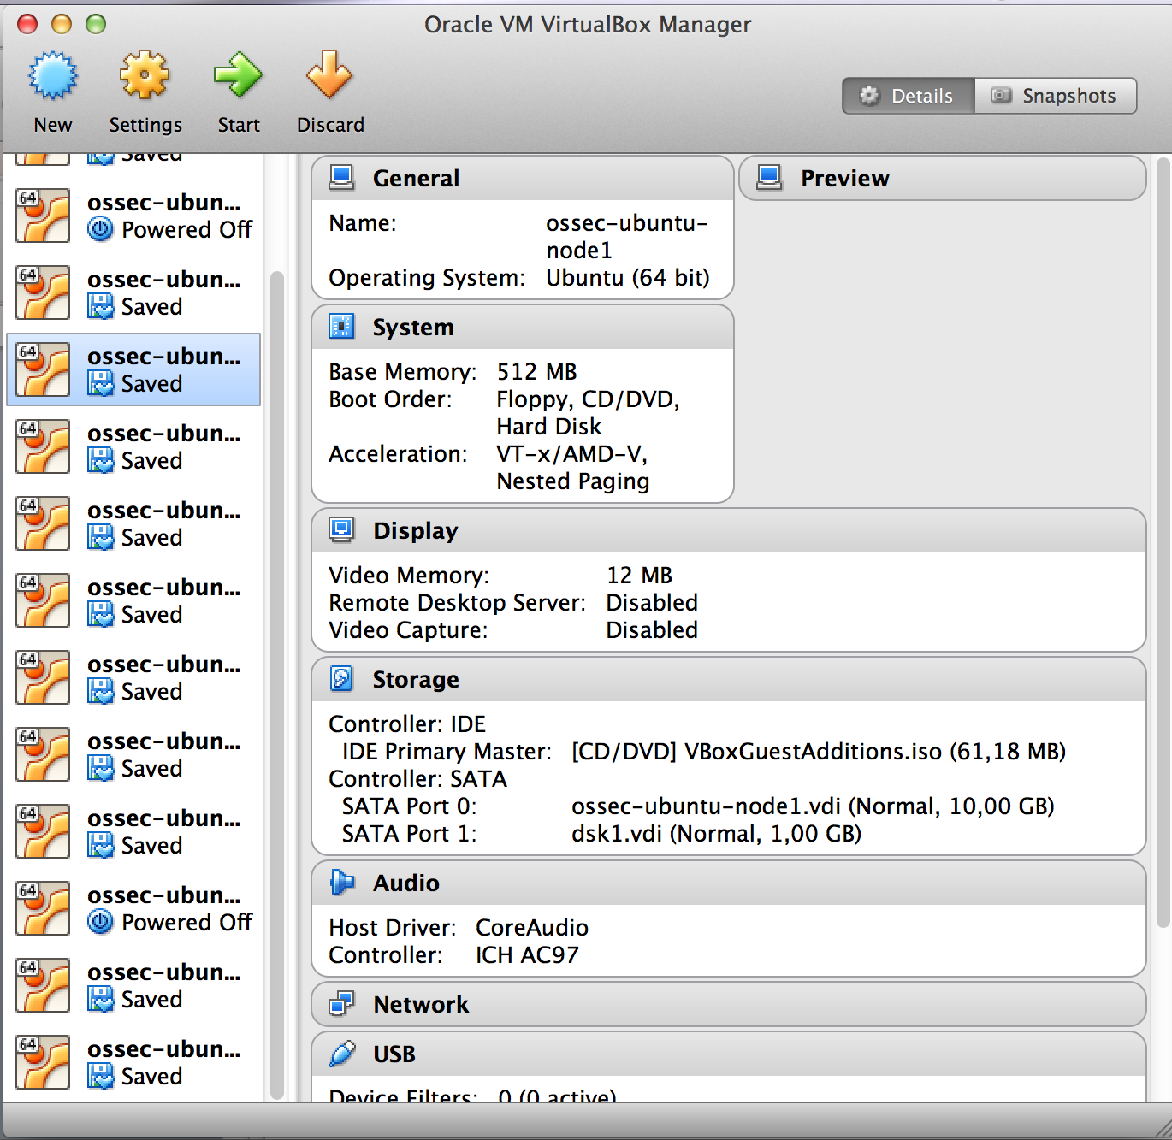
Simulated environment

Slide 3
Experiments
Ganglia: distributed monitoring system
DRBD: network based RAID-1
MySQL replication

Slide 4
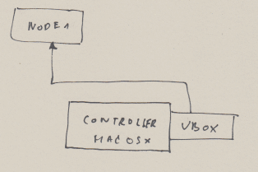
Nagios experiment

Slide 5
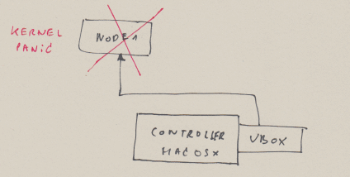
Nagios experiment

Slide 6
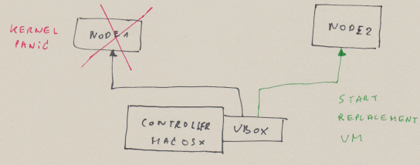
Nagios experiment

Slide 7
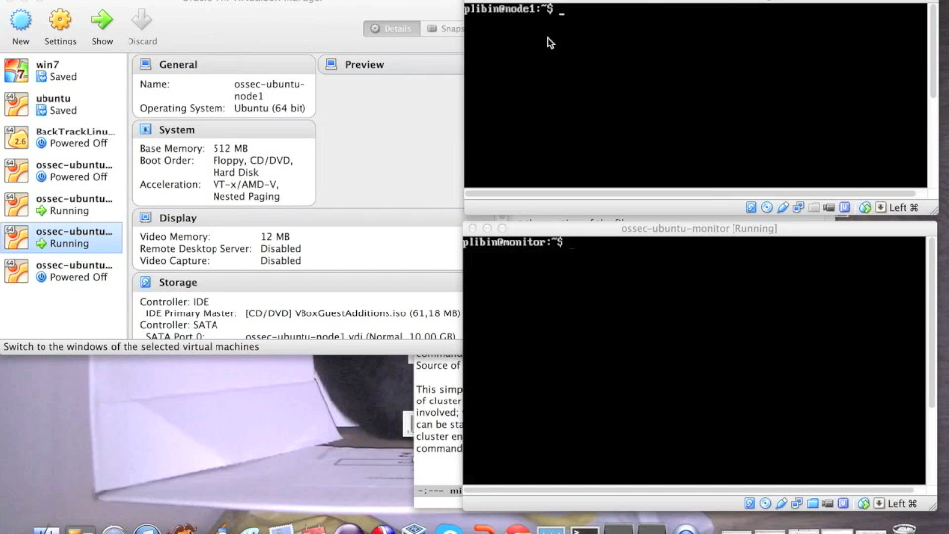
Nagios experiment

Slide 8
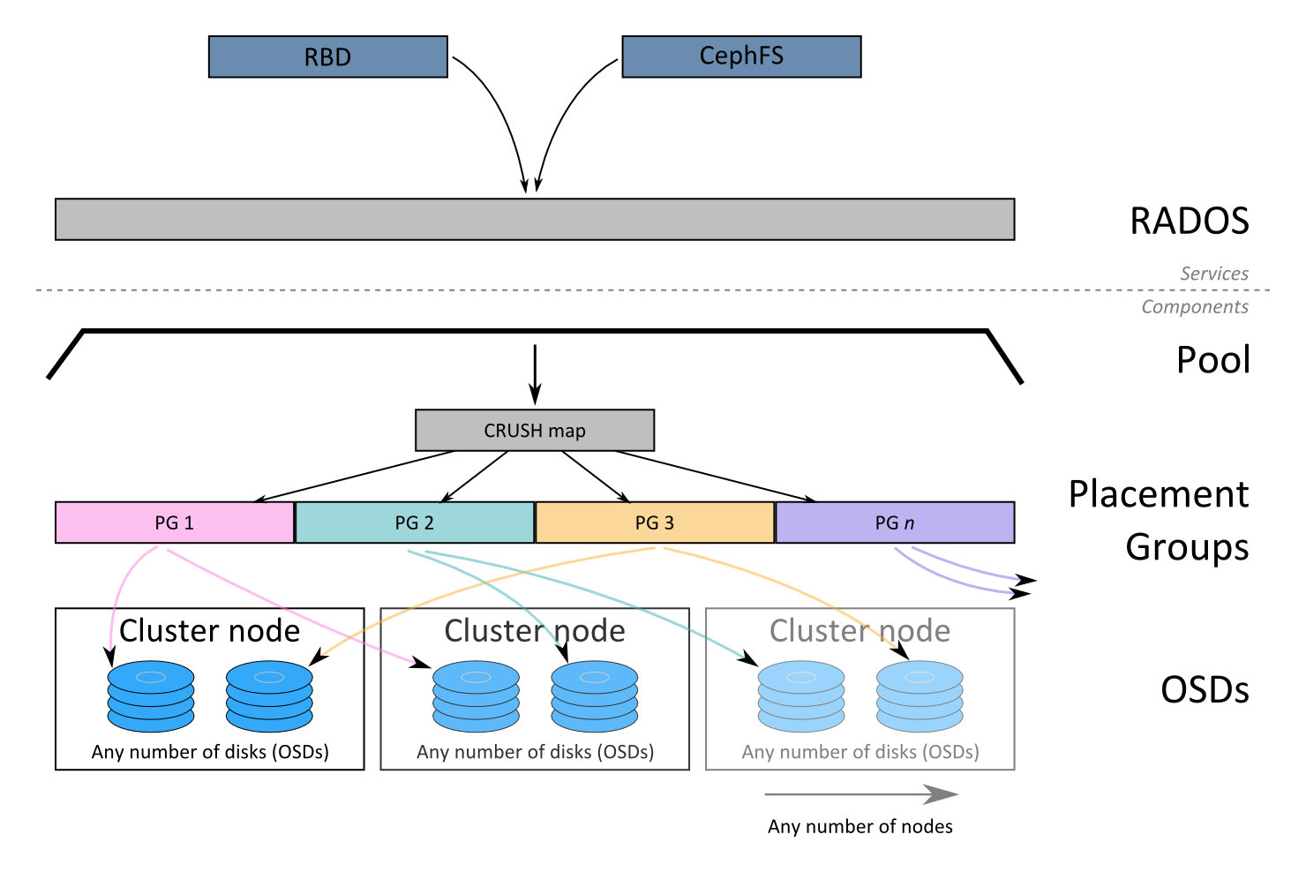
Ceph: distributed object storage

Slide 9
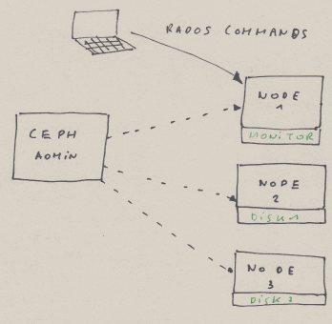
Ceph experiment

Slide 10
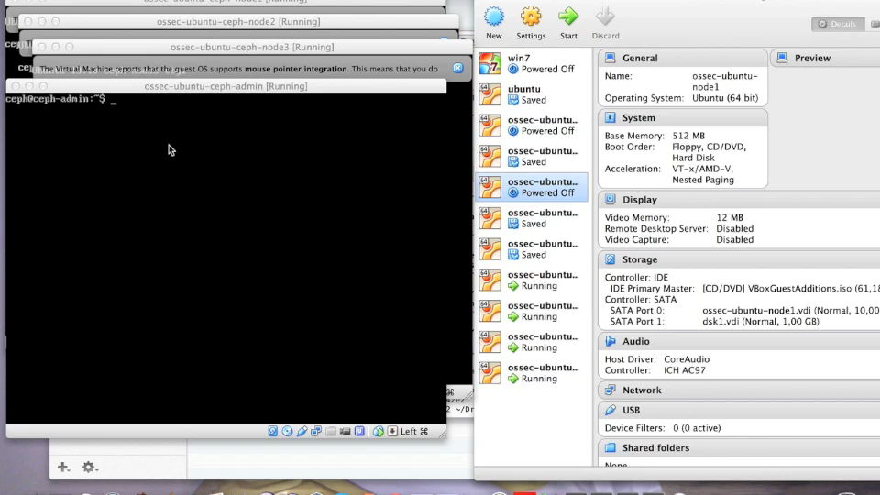
Ceph experiment

Slide 11
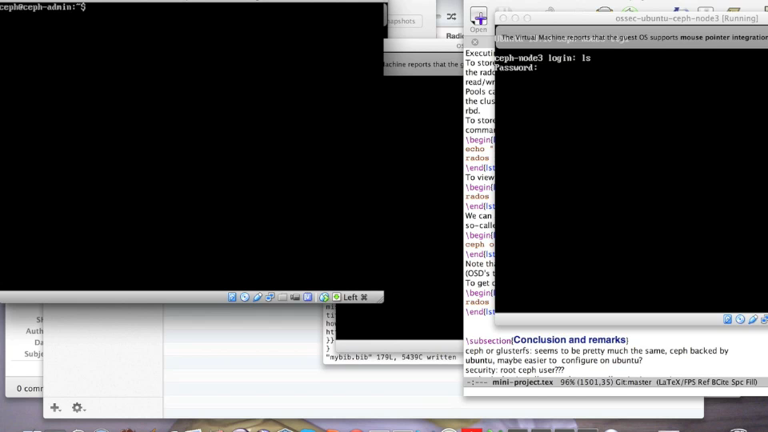
Ceph experiment

Slide 12
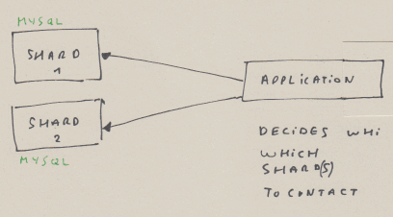
Shards experiment

Slide 13
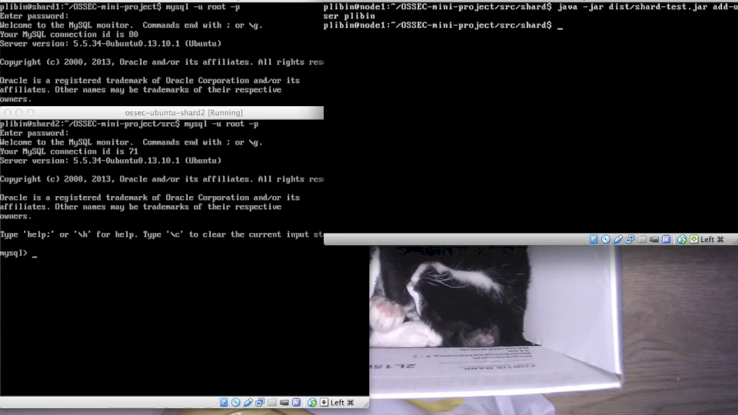
Shards experiment

Slide 14
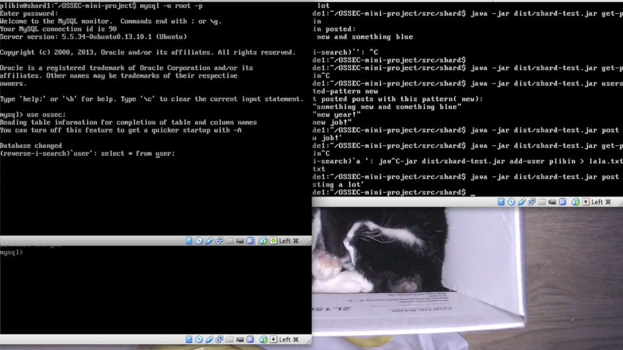
Shards experiment

Slide 15
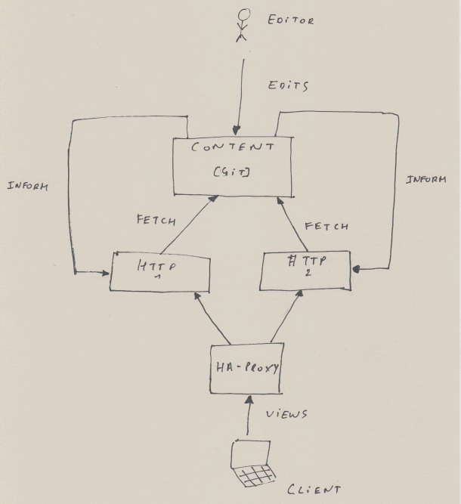
Wikipedia clone: architecture

Slide 16
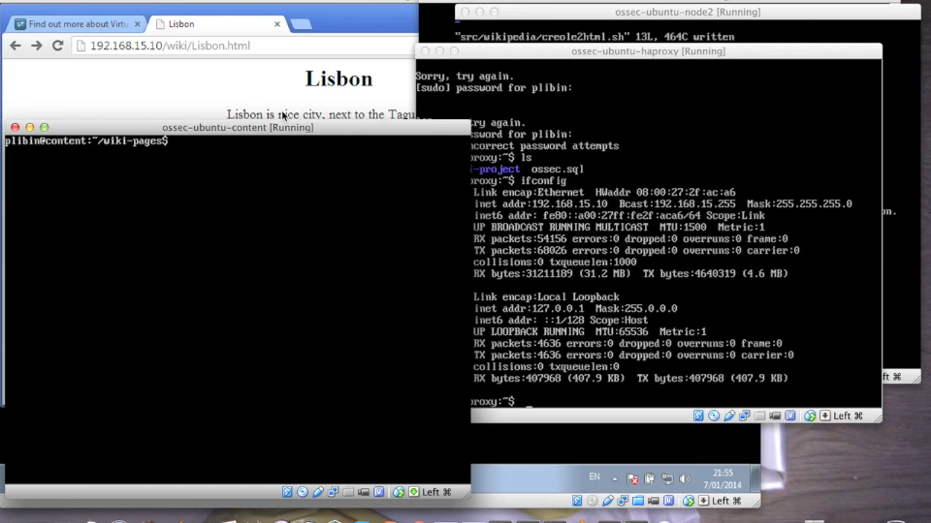
Wikipedia clone

Slide 17
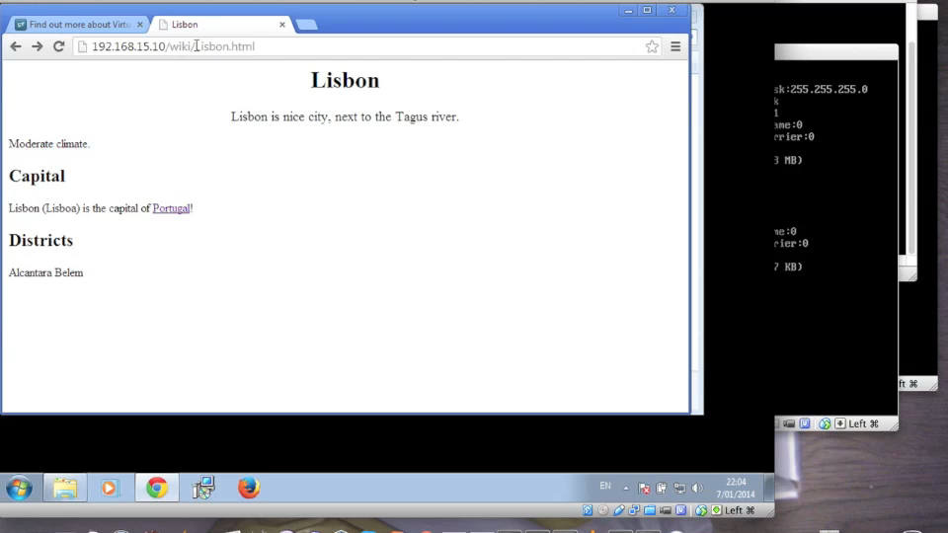
Wikipedia clone

Slide 18
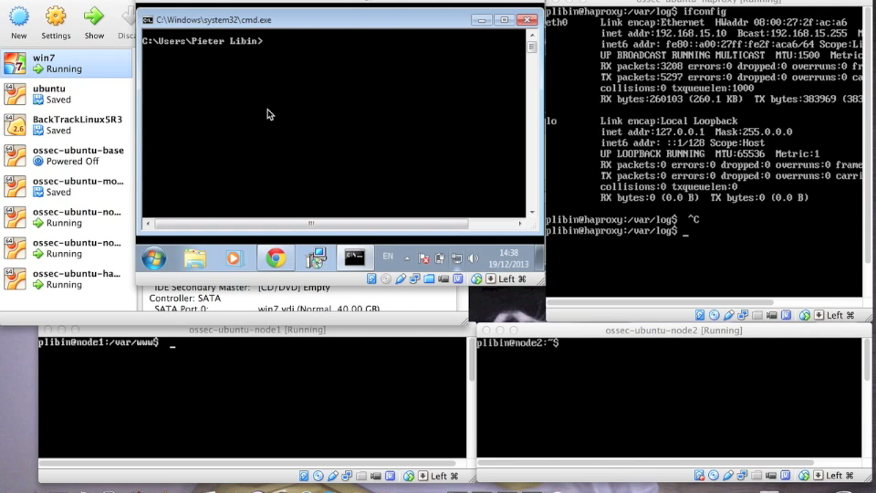
HAProxy fail experiment

